Slide 1
Selection Sort Algorithm
In selection sort, the smallest value among the unsorted elements of the array is selected in every pass and inserted into its appropriate position into the array. It is also the simplest algorithm. It is an in-place comparison sorting algorithm.
In this algorithm, the array is divided into two parts; the first is the sorted part, and the other is the unsorted part. Initially, the sorted part of the array is empty, and the unsorted part is the given array. The sorted part is placed at the left, while the unsorted part is placed at the right.

Slide 2
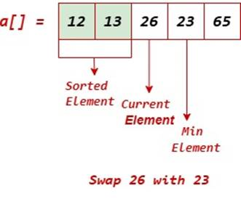
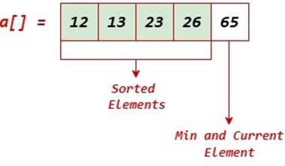

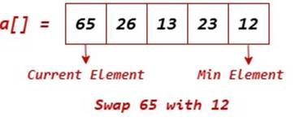
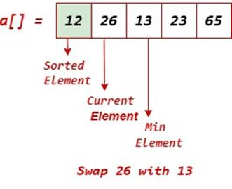
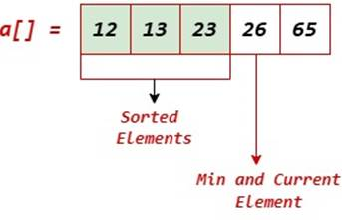
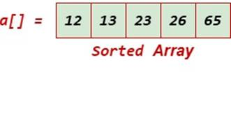
Working of Selection Sort Algorithm

